Slide 1
Proxy Design Pattern
Ahmed Mohamed Fathy - PD

Slide 2
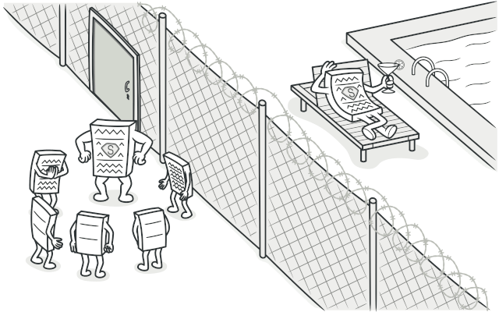
Proxy
Proxy is a structural design pattern that lets you provide a substitute or placeholder for another object. A proxy controls access to the original object, allowing you to perform something either before or after the request gets through to the original object.

Slide 3
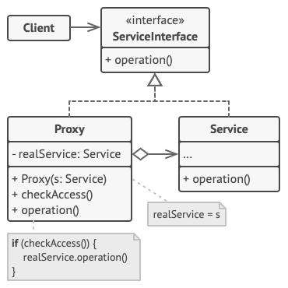
Structure

Slide 4
Pros Cons
You can control the service object without clients knowing about it.
Open/Closed Principle. You can introduce new proxies without changing the service or clients.
The code may become more complicated since you need to introduce a lot of new classes.
The response from the service might get delayed.

Slide 5


